Slide 1
Communication flow and networks
Dr Dhishna P
Associate Professor
School of Management
National Institute of Technology Karnataka

Slide 2
Levels of Communication
Extra personal
Intrapersonal
Interpersonal
Organizational
Internal operational
External operational
Personal (without purpose)
Mass Communication
1.Large reach
2. Impersonality
3. Presence of a gatekeeper

Slide 3
Formal Communication
Vertical: upward, downward
Diagonal/crosswise
Horizontal/lateral

Slide 4
Flow of communication in an organization
MD
D1
M1
M1
D2
M2
D3
M2
M3
M3
M1
M2
M3

Slide 5
Informal Network/Grapevine
Single Strand
Gossip
Probability
Cluster

Slide 6
Single Strand
a
b
c
d

Slide 7
Gossip
P
G
L
D
F

Slide 8
Probability
J
E
A
G
C
D
M
H

Slide 9
Cluster
D
E
G
B
K
L
C
A

Slide 10
Advantages
Not expensive
Rapid
Multidirectional
Cultivates harmony
A measure of public opinion
Serves as outlet for anxieties/worries
Voluntary and unforced
Quick feedback

Slide 11
Disadvantages
Contains some degree of error
Distortion of facts
Misunderstanding
Damaging effect
No responsibility
Wasting time

Slide 12
How to make Grapevine effective?
Should not ignore information received through grapevine
Should use this channel to supplement formal channel
Should identify and not threaten the main sources of information
Should be used to understand human relationship and psychology of employees.

Slide 13
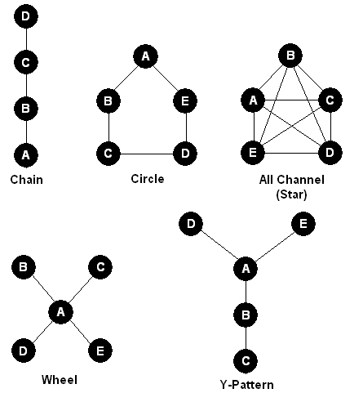
Formal networks

